Slide 1
Spring Data JPA

Slide 2
Jakarta Persistence API (JPA) is a specification for mapping Java classes to database tables
Hibernate is an ORM (Object–relational mapping) framework that implements the JPA specification
Spring Data JPA is an additional framework on top of Hibernate (or another JPA provider)

Slide 3
JPA basics
Defining queries
Assocations
Projections
Programmatic Query Creation

Slide 4
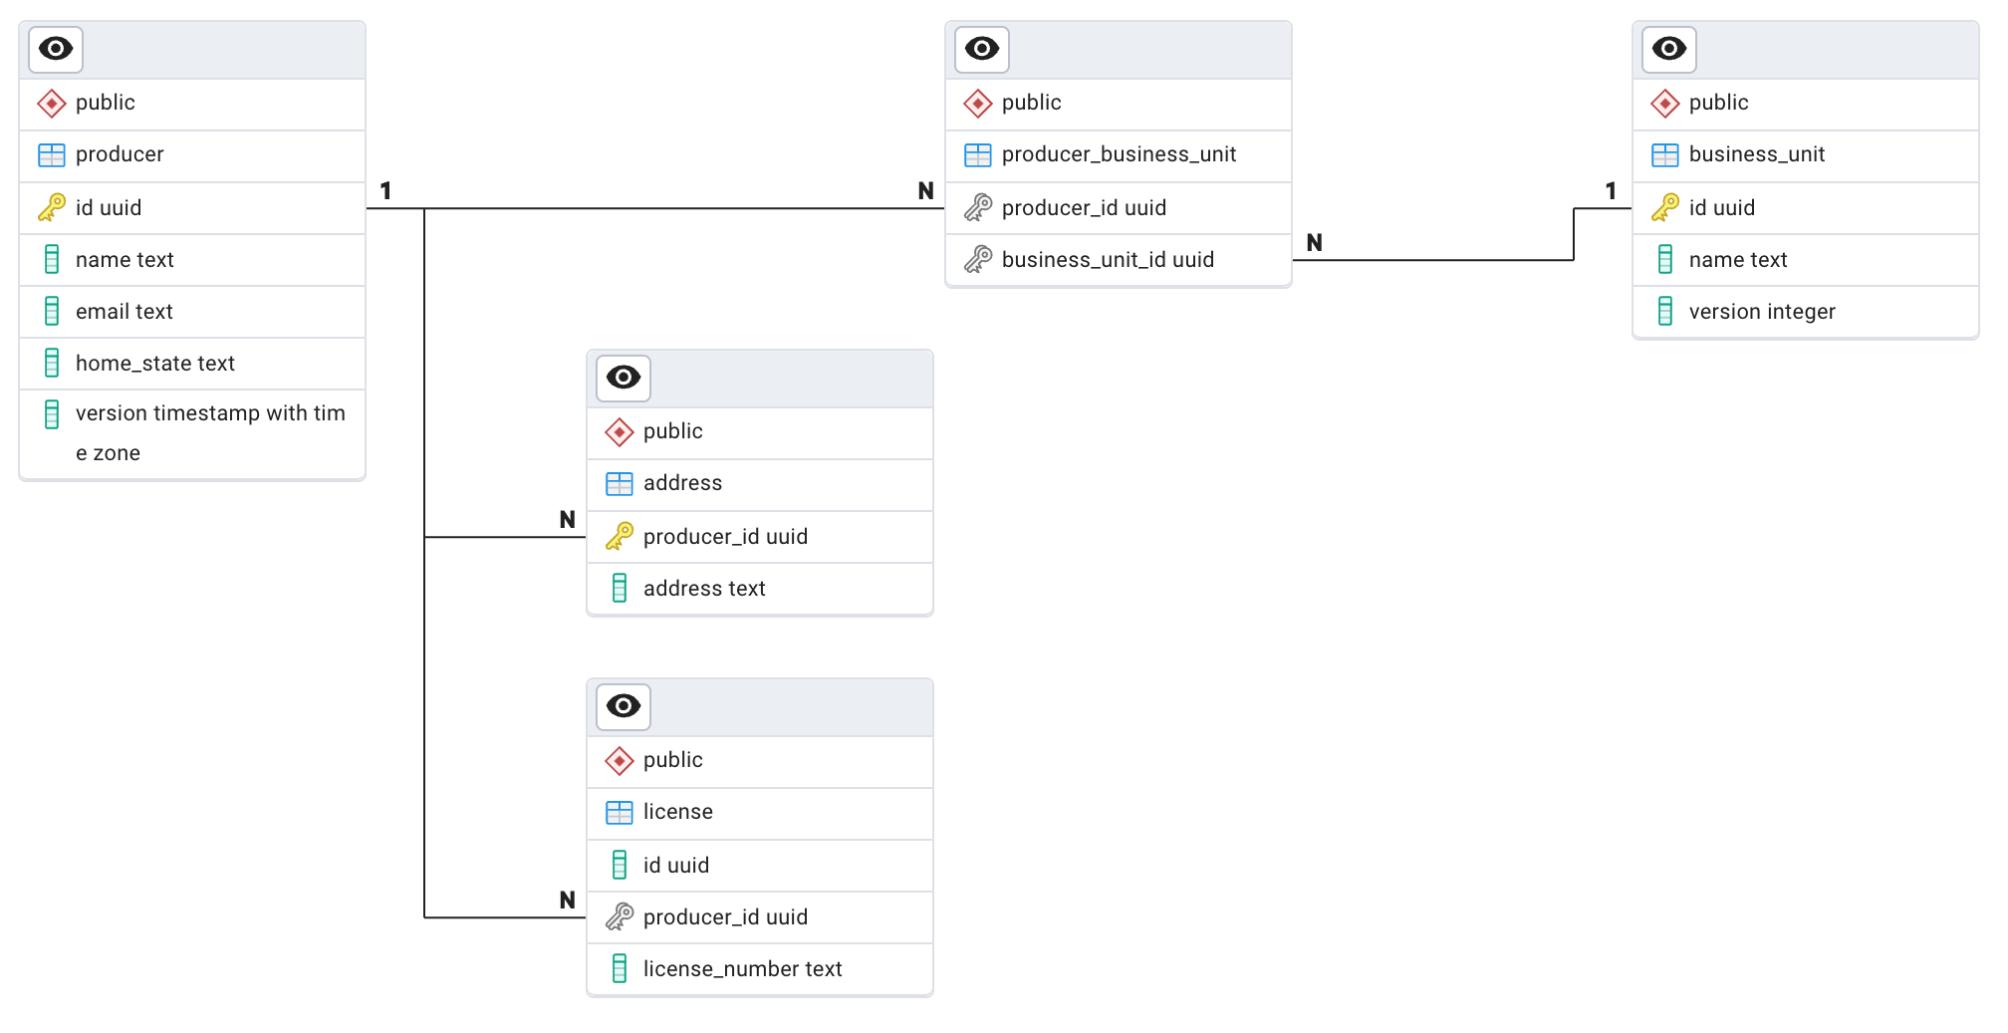

Slide 5
JPA basics - @Entity
An entity is a Java class that maps a table and its relationships with other entities
Entities must have
a parameterless constructor
getters and setters for every attribute
a field annotated with @Id
Tables and fields are mapped from a Java class to a table using camel case to underscore by default (CamelCaseToUnderscoresNamingStrategy)

Slide 6
Repository
The Repository interface provides out of the box methods for accessing and modifying entities
delete(T entity)
deleteById(ID id)
findAll()
findById(ID id)
save(T entity)
saveAll(Iterable<T> entities)
Hibernate handles mapping of the entity

Slide 7
Persistence Context
Keeps track of changes to entities and persists them once the transaction is ready to be committed
The SQL is executed when the persistence context is “flushed”
Each transaction has its own persistence context
Also called the first level cache
An entity can exist in new/transisent, managed/persistent, detached, or removed states
All changes to a managed entity are persisted, even if you don’t call repository.save

Slide 8
Persistence Context - Flushing
When the transaction is completed, Hibernate will perform what’s called a “flush”
Hibernate will execute the SQL to insert new entities and update existing entities at this stage
When the persistence context is flushed, operations are executed in a defined order by Hibernate
“The order in which SQL statements are executed is given by the ActionQueue and not by the order in which entity state operations have been previously defined.” – from the Hibernate user guide

Slide 9
OrphanRemovalAction
EntityInsertAction or EntityIdentityInsertAction
EntityUpdateAction
QueuedOperationCollectionAction
CollectionRemoveAction
CollectionUpdateAction
CollectionRecreateAction
EntityDeleteAction

Slide 10
Query Methods
You can also define your own queries in your Repository
These can be
Derived queries
JPQL (Jakarta Persistence Query Language) or native SQL queries

Slide 11
Derived queries
Derived queries are created using the method name
Method names are named according to the properties on your entity
Spring Data JPA will generate the query based on the keywords
findByHomeState(String homeState);
deleteByBusinessUnitsContainingAndHomeStateIsLikeIgnoreCase
Search Spring Data JPA repository keywords for a full list of supported keywords

Slide 12
@Query
You can provide your own query using the @Query annotation
Supports either JPQL or native SQL
The @Query annotation also supports native SQL by setting the nativeQuery parameter

Slide 13
@Modifying
Use @Modifying with a @Query to create a query that modifies data. Useful for bulk operations
@Modifying queries are executed immediately, so you either need to flush the persistence context manually or set the flushAutomatically and clearAutomatically parameters

Slide 14
Associations
@OneToOne
@OneToMany and @ManyToOne
@ManyToMany
Associations can be bidirectional or unidirectional, meaning we model the association on either one side or both
Associations can be eagerly or lazily fetched, so we either load the association when we load the entity or only when we access it
This is the most likely place where you’ll run into performance issues, so make sure you enable SQL logging
Fortunately, most of these issues have solutions

Slide 15
One-to-one
@OneToOne
mappedBy goes on the non-owning side of the relationship (the side without the foreign key) and designates the field in the target entity that owns the relationship
Be wary of N+1 problem when modeling relationships

Slide 16
N+1 Problem
The N+1 problem occurs when we perform N additional queries to retrieve data that could have been retrieved in the primary query
Not unique to Hibernate, but it is a common issue when working with Hibernate
To avoid this issue, we can create a custom @Query that fetches the data in the primary query

Slide 17
One-to-many
@OneToMany and @ManyToOne

Slide 18
Unidirectional one-to-many
In a unidirectional one-to-many, Hibernate will first insert the licenses then process the Producer.licenses list to set the foreign key on the License entities (done during the CollectionRecreateAction phase)
The license entity cannot access the identifier of the Producer entity

Slide 19
Bidirectional one-to-many
Make sure both sides of the relationship are synchronized using convenience methods on the parent. Otherwise, the relationship will not be persisted

Slide 20
Many-to-many
The owner of the relationship is arbitrary
Use Set

Slide 21
Projections
Projections can be used to limit what your query selects
Interface-based projections
Expose accessor methods for the properties to be read
Class-based Projections
Fields to be loaded are determined based on the parameter names of the constructor

Slide 22
Programmatic Query Creation - Specifications
Specifications can be used to programmatically build queries by combining filtering criteria
On your repository, extend JpaSpecificationExecutor<T> to support specifications
Specification is a FunctionalInterface with a toPredicate method

Slide 23
Query by Example
Query by example can also be used to dynamically create queries
By providing an example of an entity and ExampleMatcher, we can dynamically generate queries

